Slide 1
Integrated Business Planning
MGMT 324
WEEK 3
Reviewing Structures – Defining Terms – Structural vs. HR
Paul Pinkus
ppinkus@my.centennialcollege.ca
Notes:
1

Slide 2
Agenda
Answering your questions
Short review
Looking at your structures
Learn to integrate what you have learned in four previous semesters
Defining terms (Group exercise)
Daniel Pink’s Theory of Motivation
Notes:
2

Slide 3
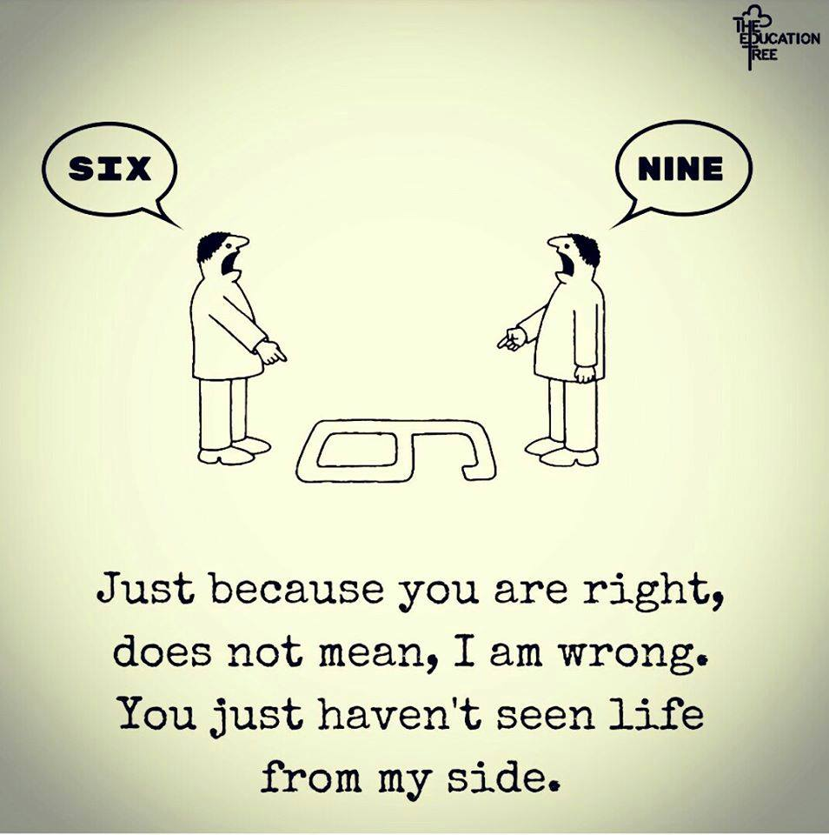
What is re-framing?

Slide 4
Your Questions
Q: How do we know what questions to ask in the field study?
A: You will be working on developing an interview questionnaire of 16 questions during weeks 8 and 9. The questions will be based on the four frames.
Any other questions.
Notes:
4

Slide 5
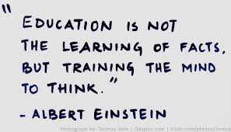
Notes:
5

Slide 6
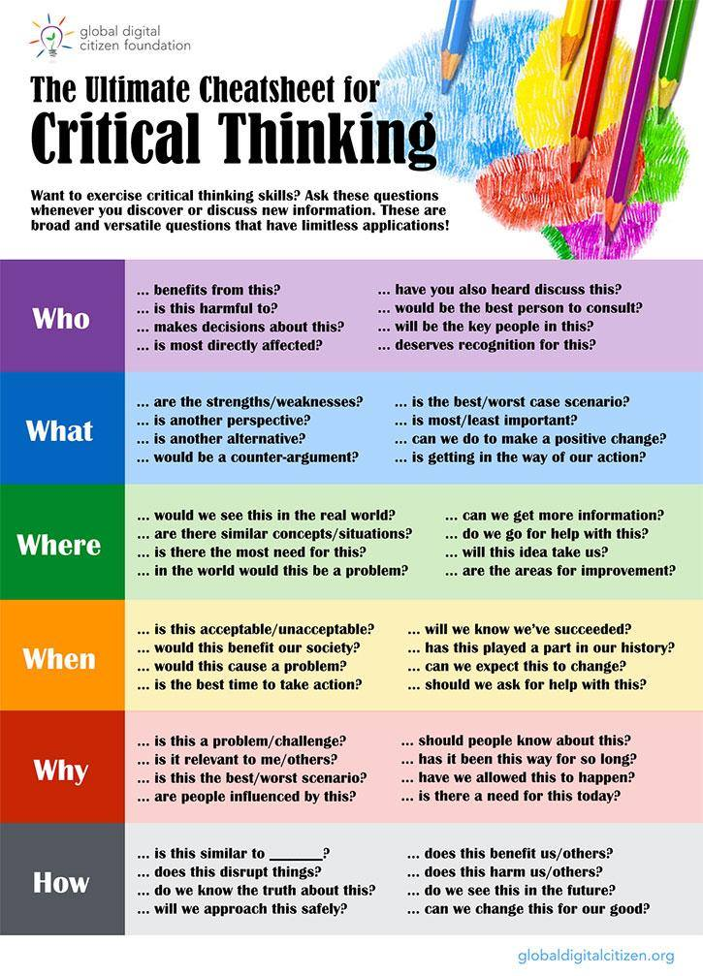
Notes:
6

Slide 7
Looking at your structures
One member from each group presents
I will ask questions / provide feedback
Anyone from group can respond to question / feedback
Notes:
7

Slide 8
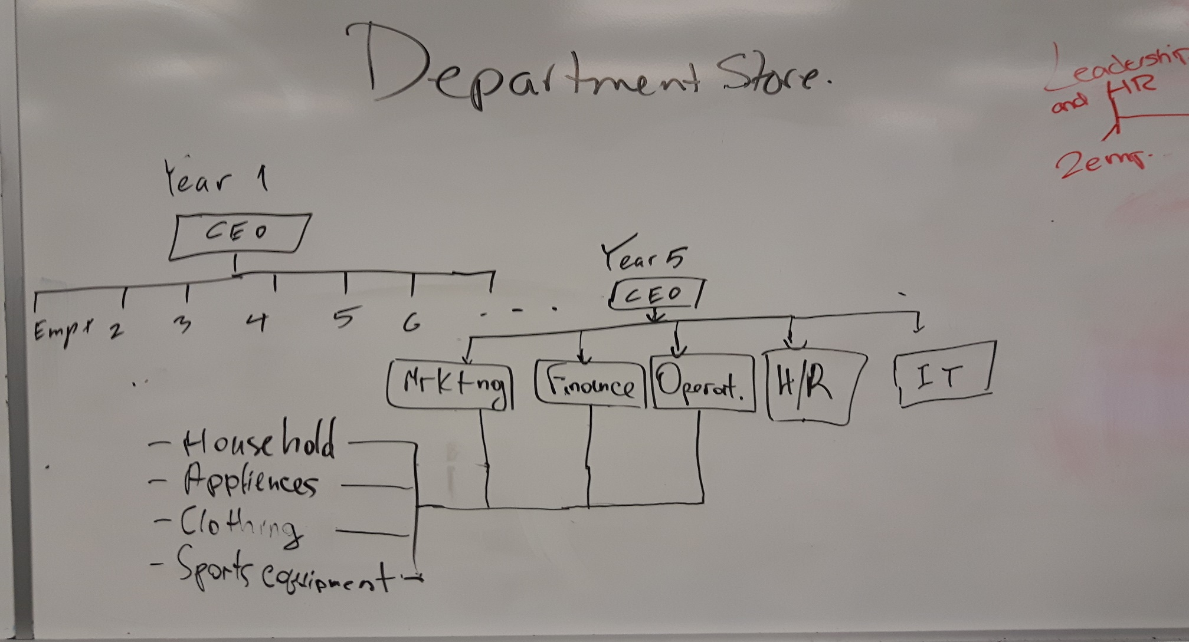
Department Store

Slide 9
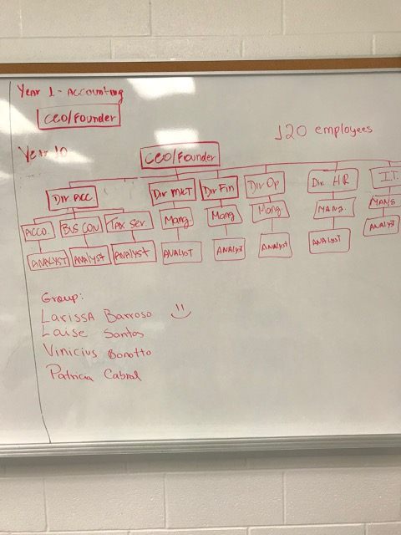
Accounting Services

Slide 10
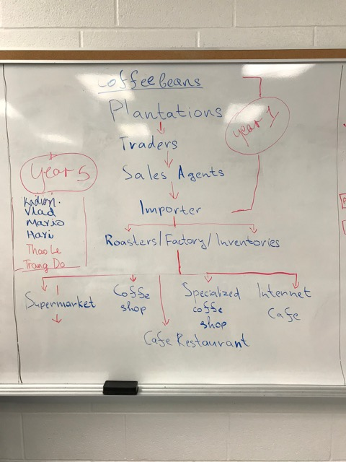
Coffee Beans

Slide 11
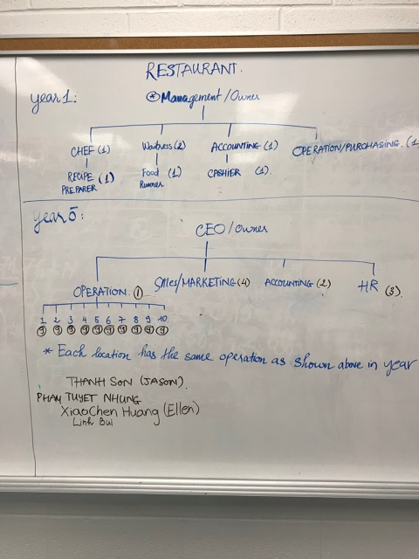
Restaurant

Slide 12
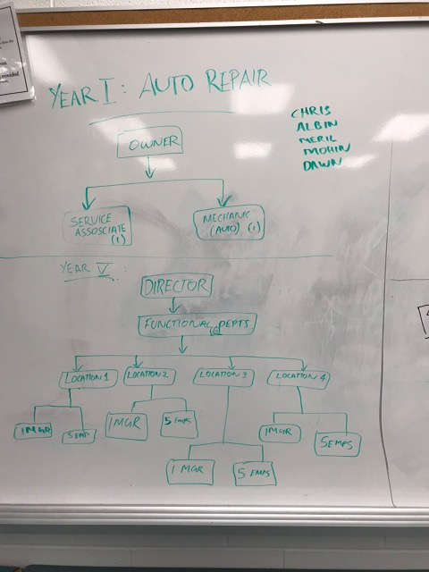
Auto Repair

Slide 13
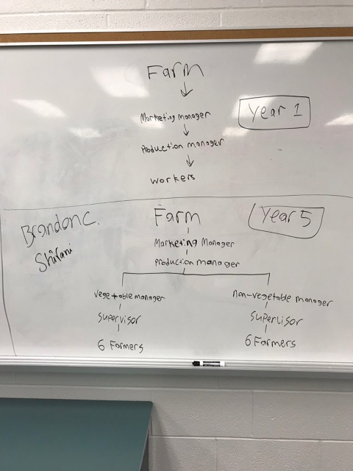
Farm

Slide 14
Standard “Functional” Areas
Management / Executive Function
Supply / Production
Sales / Marketing
Accounting
Human Resources
Information Technology

Slide 15
Structural Assumptions
Achieve organizational goals and objectives
Increase efficiency and performance via specialization and division of labor
Appropriate forms of coordination and control
Organizations work best when rationality prevails
Structure must align with circumstances
Problems arise from structural deficiencies

Slide 16
Transformation and Change
Transformation and Change

Slide 17

Motivation
Daniel Pink's Theory of Motivation
Motivation

Slide 18
Defining Terms
In groups, create a definition for the assigned terms. Provide at least two examples to illustrate your meaning. Elect 2 speakers who are prepared to explain your definition and examples to the class.
 | Chapter 3 | Chapter 6
1 | Differentiation | Theory X
2 | Integration | Theory Y
3 | Social architecture | Argyris’ personality-organization theory
4 | Vertical coordination | Self-Actualization
5 | Lateral coordination | Maslow’s Hierarchy of Needs
6 | Core technology | Daniel Pink’s Theory of Motivation

